Slide 1
C1Po3D-06: Streamlined Heat Leak Estimation for Vacuum Jacketed Cryogenic Pump Assemblies
Chris Rista, P.E.
Senior Sales Engineer
CEC/ICMC 2025 Abstracts & Technical Program – 19 May 2025

Slide 2
Abstract:
Notable cost is invested in the liquification of cryogenic fluids such as liquid Nitrogen, Helium, Hydrogen, and Argon. End users have an interest in knowing the level of heat leak cryogenic systems experience, and convenient methods of heat leak calculations. End-users value pump designs that minimize heat leak in cryogenic systems to improve system efficiency and reduce operating costs. At the engineering and design phase, heat leak calculations assist in establishing the efficacy and confirmation of designs for vacuum jacketed, cryogenic, extended shaft pump assemblies as well as gaseous cryogenic compressors and blowers. When compared to more sophisticated finite element (FEA) analysis methodologies provided by engineering analysis programs such as ANSYS®, this relatively straight forward, one dimensional heat leak analysis method presented provides reliable first-pass estimates that assist in design optimization by achieving similar accuracy while being faster and easier to implement, making the method an ideal tool for early design evaluation.

Slide 3
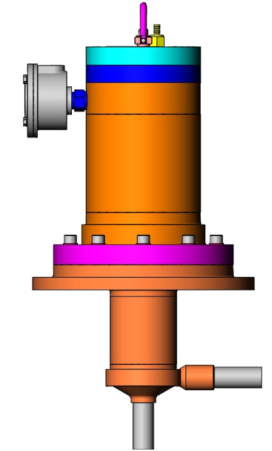
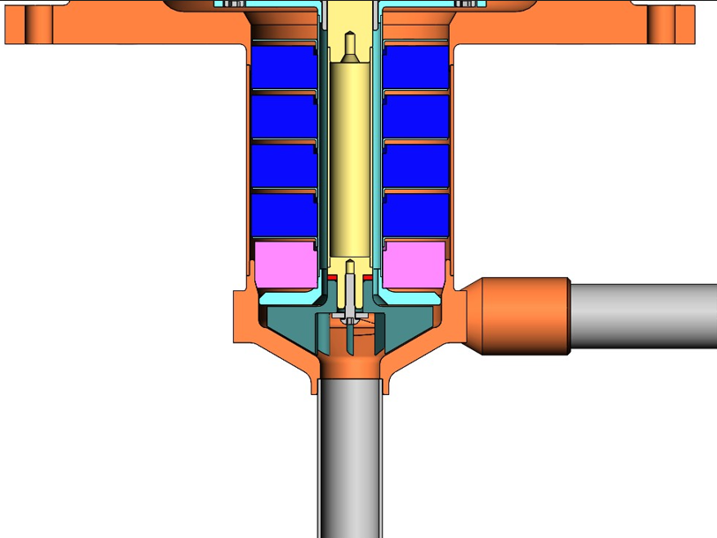
The Subject Cryogenic, Extended Shaft Pump Assembly

Slide 4
Thermal Acoustic Oscillation (TAO) Shields
A large axial temperature gradient can cause the cold gas inside the extended shaft to rapidly expand. This expanding gas then pushes the warmed gas into the cold impeller end of of the extended shaft. If the driving inertial force is large enough, a low pressure is generated in the warm end of the extended shaft. The existence of such a low pressure near the warm end leads to the reverse flow of cold dense gas back towards the warm end.
The shields shown in the Cryogenic Pump Assembly extended shaft are what are known as Thermal Acoustic Oscillation (TAO) shields which prevent any notable circulation of Hot Helium Gas circulating from the hot Pump Mounting Plate and motor cavity, carrying heat down to the Liquified Helium. TAO can increase the magnitude of Heat Leak by up to 4 times or more.
In the absence of TAO, convection is the heat transfer through the movement of fluids (liquids or gases), where warmer, less dense fluid rises and cooler, denser fluid sinks, creating currents. The shields shown also act as anti-convection shields.

Slide 5
Definition of Variables:
English Units:
Thermal Conductivity of Material– K, BTU/[hr·ft²·°F/ft]
Cross Sectional Area – A, inches² or ft²
Length From Mounting Flange to behind the Pump Impeller – L, inches
Temperature Difference Between Mounting Plate Temperature and the Process Helium – dT, °F
Heat Transferred – Q, Watts
Metric Units:
Thermal Conductivity of Material– K, Watts/[m·K]
Cross Sectional Area – A, cm²
Length From Mounting Flange to behind the Pump Impeller – L, cm or meters
Temperature Difference Between Mounting Plate Temperature and the Process Helium – dT, K
Heat Transferred – Q, Watts
The equation for Heat Transfer (Q) is then:
Q = A/L x ∫ K(T) dT where the heat transfer coefficient K changes with the change in temperature T across ‘L’.

Slide 6
Unit Continuity of The Heat Leak Calculation:
The equation for Heat Transfer (Q) (Heat Leak) is:
Q = A/L x ∫ K(T) dT where the heat transfer coefficient K changes with the change in temperature T along the Heat Transfer Length ‘L’ .
Q = Area:ft.² / Length: in. x ∫ K(T) dT: BTU/[HR⋅ft²⋅°F/ft] x (°F)
Unit Continuity with Conversion Factors to Achieve Heat Leak Q in Watts (Joules/sec.):
Q = ft²/ in. x BTU/[HR⋅ft²⋅°F/ft] x (°F) x 1055.05585 Joules/BTU / 3,600 sec./Hr. x 12 in./ft
Q = ft²/ in. x BTU/[HR⋅ft²⋅°F/ft] x (°F) x 1055.05585 Joules/BTU / 3,600 sec./Hr. x 12 in./ft
Q = Joules/sec. = Watts
Of course, the calculation is similar for metric units for Q = Watts.
Key Conversion Factors:
1,055.05585 Joules/BTU
3,600 sec./Hr.
12 in./ft.

Slide 7
Steps to Dimensional Modeling
The first step to take is to model the heat transfer path from the back of the Pump Impeller and Impeller Housing to the bottom of the Cryogenic, Jacketed, Extended Shaft Pump Assembly Mounting Plate.
This means the thickness of the conductive materials, the stainless steel and the Helium, need to be determined for the Heat Transfer Model.
Measure Stainless Steel Shaft Extension Wall Thicknesses, and All Interstitial Spaces (Area) for Helium Conductivity
The Heat Transfer Length L is assumed to have a uniform Thermal Gradient from the Cryogenic Liquid Helium Temperature at the back of the Pump Impeller to the Pump Assembly Mounting Plate heated by the Pump Motor at a steady state operating condition.
Heat Transfer Length, L ----------

Slide 8
Steps to Dimensional Modeling
The first step to take is to model the heat transfer path from the back of the Pump Impeller and Impeller Housing to the bottom of the Cryogenic, Jacketed, Extended Shaft Pump Assembly Mounting Plate.
This means the thickness of the conductive materials, the extended shaft stainless steel and the Helium, need to be determined for the Heat Transfer Model.
Measure Stainless Steel Shaft Extension Wall Thicknesses, and All Interstitial Spaces (Area) for Helium Conductivity
S.S. Wall Thickness → ←-
S.S. Wall Thickness -> <---
<-Diameter->
< -------
Outer Housing
<------------------ Diameter ---------------->
< > Helium Interstitial Space
Helium Interstitial Space < ------------- >
< ------------- > Helium Interstitial Space
<-Diameter->
< -----------------------
Support Tube
S.S. Wall Thickness → ←-
Helium Interstitial Space < >
< -------------------------
Shaft

Slide 9
Steps to Dimensional Modeling
The thickness and cross-sectional areas of the conductive materials, the stainless steel and the Helium, need to be determined for the Heat Transfer Model.
Based on the stainless steel wall thicknesses and the Helium volume in the interstitial spaces shown on the previous slide, calculate the annular areas of the conductive stainless steel and of the Helium.

Slide 10
Steps to Mathematical Modeling
To set-up the mathematical modeling and ultimately the actual Heat Leak calculation, the operating condition of the Pump Assembly must be considered and specifically the liquid cryogen fluid temperature into the Pump Assembly (Ta).
In this case the Liquid Helium temperature (Ta) is -451.57 °F.
In this case the Heat Transfer Length L is 5.745 inches for Barber-Nichols’ Model BNHeP-21-000 Cryogenic, Jacketed, Extended Shaft Pump Assembly.
Finally, understanding the Pump Assembly motor power draw at the steady state operating condition is useful as one must estimate and assume the effect the motor has on heating the Pump Assembly Mounting Plate.
This is an arbitrary decision regarding the Pump Assembly Mounting Plate temperature.
For motors with power levels of 10 HP (7.46 kW) or more the Pump Assembly Mounting Plate temperature is assumed to be 115 °F.
For motor power levels in the low Watt range, the Pump Assembly Mounting Plate temperature is assumed to be 75 °F.
For the subject model BNHeP-21-000 Cryogenic, Jacketed, Extended Shaft Pump Assembly under consideration, with a motor power draw at steady state of approximately 1.71 kW, the Pump Assembly Mounting Plate temperature (Tb) is assumed to be 100 °F.

Slide 11
Steps to Mathematical Modeling
Once the Pump Assembly Mounting Plate temperature (Tb) is assumed, the final inputs to the Heat Leak spreadsheet model can be accomplished with the few required inputs as follows:

Slide 12
Stainless Steel Thermal Conductivity (K) as a function of (T)
The Thermal Conductivity (K) properties for Stainless Steel over a broad temperature range were determined as follows.
Notable is the 4th order equation derived for Stainless Steel Thermal Conductivity (K) as a function of Temperature (T) based on data supplied by NIST and Barber-Nichols’ own heritage information on the left for K(T).

Slide 13
Stainless Steel Thermal Conductivity (K) as a function of (T)
The Thermal Conductivity (K) properties for Helium over a broad temperature range were determined as follows using RefProp 10 Equation-of-State for the Helium (K) as a function of Pump Inlet pressure (P1) and Temperature (T) across a broad temperature gradient in accord with the chart on the left.
Notable is the 2nd order equation derived for Helium Thermal Conductivity (K) as a function of Temperature (T) to be used in the mathematical integration in the following second slide.

Slide 14
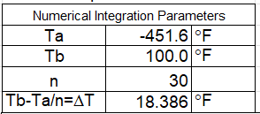
Integration of ∫K(T) dT for Stainless Steel
Now that the key inputs of physical and thermal properties have been determined and input into the spreadsheet, the Thermal Conductivity (K) can be determined by Numerical Integration across the Thermal Gradient (dT) from
-451.57 °F to +100 °F across the pump shaft extension ‘L’ : ∫K(T) d(T)
The set-up for the 30-step numerical integration from -451.57 °F to +100 °F for both the Stainless Steel and the Helium is as follows:

Slide 15
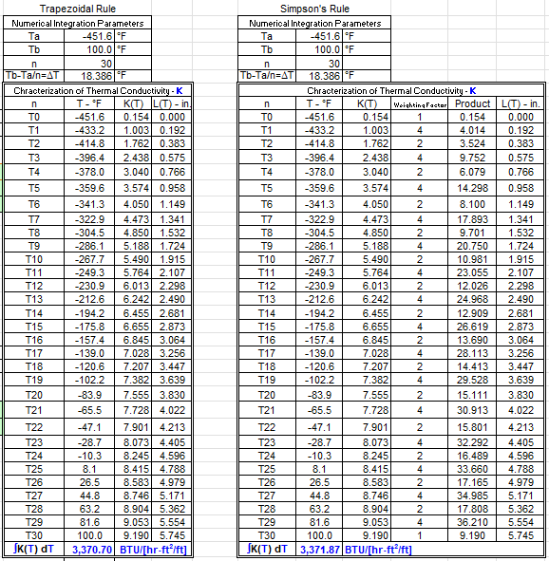
Integration of ∫K(T) dT for Stainless Steel
Now that the key inputs of physical and thermal properties have been determined and input into the spreadsheet, the Thermal Conductivity (K) can be determined by Numerical Integration across the Thermal Gradient (dT) from
-451.57 °F to +100 °F across the pump shaft extension ‘L’ : ∫K(T) d(T)
Two methods of integration are used, the Trapezoidal Rule and Simpson’s Rule for integration. Refer to any calculus textbook for these numerical integration methods:

Slide 16
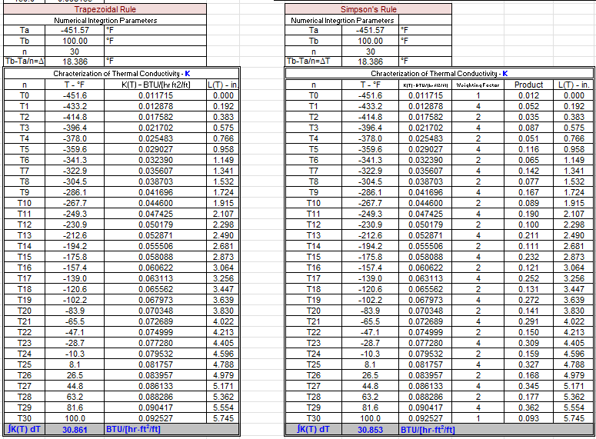
Integration of ∫K(T) dT for Helium
As with Stainless Steel, now that the key inputs of physical and thermal properties have been determined and input, the Thermal Conductivity (K) can be determined by Numerical Integration across the Thermal Gradient (dT) from
-451.57 °F to +100 °F across the pump shaft extension ‘L’ : ∫K(T) d(T) for Helium
Again, two methods of integration are used, the Trapezoidal Rule and Simpson’s Rule for integration:

Slide 17
Integration Results of ∫K(T) dT for Stainless Steel and Helium
The results of the integration of ∫K(T) d(T) for Stainless Steel and Helium from -451.57 °F to +100 °F across the pump shaft extension ‘L’ are as follows:
Stainless Steel:
Helium:
Comparing the Trapezoidal and Simpson’s Rule results, the integrated values are very close to one another. In both instances, as a matter of conservatism, the higher result is used for Both Stainless Steel and Helium integration results to ultimately calculate the Pump’s Heat Leak (Q).

Slide 18
Final Input with Output Heat Leak Results
The complete Table input and output results for the Pump’s Heat Leak (Q) across the Stainless Steel extended shaft elements, considering the temperature gradient (ΔT) along the pump extended shaft (L) are as follows:
Note that if one were to “nominalize” K as shown above to match the Heat Leak for the Shaft Area (A) for the Simpson’s Rule integration (∫Q = 1.8226 Watts), the multiplication of K dT = 6.1131 x 551.57 = 3,371.80 BTU/[Hr⋅ft²/ft]
Note this is very close to the integrated results:

Slide 19
Final Input with Output Heat Leak Results
The complete Table input and output results for the Pump’s Heat Leak (Q) across the Helium within the Stainless Steel extended shaft’s two interstitial spaces, considering the temperature gradient (ΔT) along the pump extended shaft (L) are as follows:
The total calculated Heat Leak (Q) is the Heat Leak across the Stainless-Steel Extended Shaft elements of 15.256 Watts plus the Heat Leak across the Helium in the interstitial spaces between the Stainless Steel Extended Shaft elements of 1.447 Watts. Total Heat Leak Q is then: 15.256 Watts + 1.447 Watts = 16.702 Watts

Slide 20
In Closing
The Heat Leak calculation for a Cryogenic, Jacketed, Extended Shaft Pump Assembly can be assembled within one tab of an XCEL Spreadsheet. Once modeled, compiled, and assembled, the Heat Leak calculation can be adopted to numerous Cryogenic fluids and Cryogenic Pump Assembly geometries. The calculated Heat Leak results are reasonably close to calculations provided by more sophisticated engineering analysis programs such as ANSYS® Finite Element Analysis (FEA). This relatively straight forward, one dimensional Heat Leak analysis method presented provides reliable first-pass estimates that assist in design optimization by achieving similar accuracy while being faster and easier to implement, making the method an ideal tool for early design evaluation.

